Slide 1

Adapting the model to your needs Federico Cairoli, MD, MSc. Health economist at Triangulate Health Ltd September 2023

Slide 2
You may need to model:
A different cycle length (monthly, daily, etc.)
A different number of states
A different discount rate (3.5%, 5%, etc)
A different treatment effectiveness measure (RR, OR, etc.)
Incorporating utilities into your model (to obtain incremental costs per QALY gained)

Slide 3
Please, do not worry about:
Adding all-cause mortality rates per age.
Running deterministic or probabilistic sensitivity analysis

Slide 4
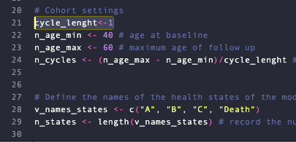
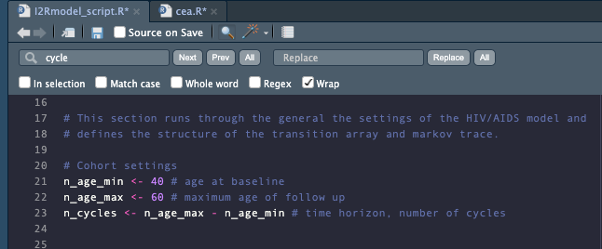
a. A different cycle length

Slide 5
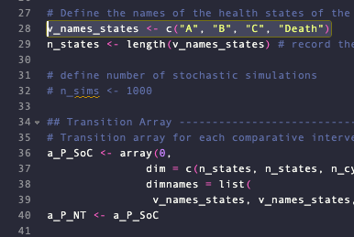
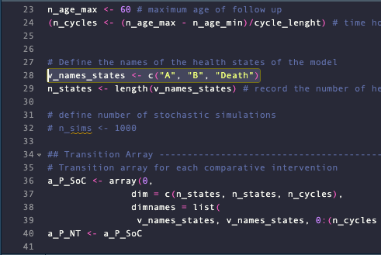
b. A different number of states

Slide 6
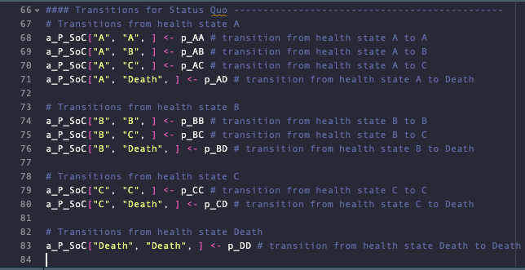
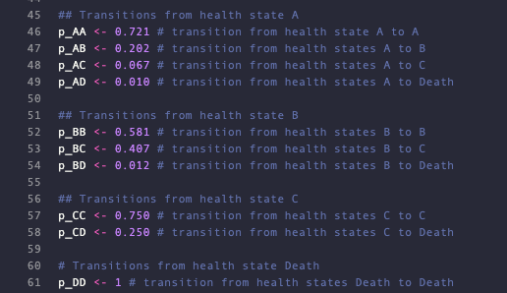
b. A different number of states

Slide 7
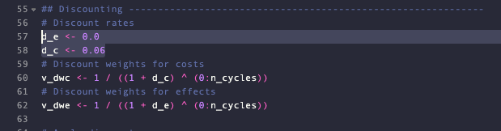
c. A different annual discount rate

Slide 8
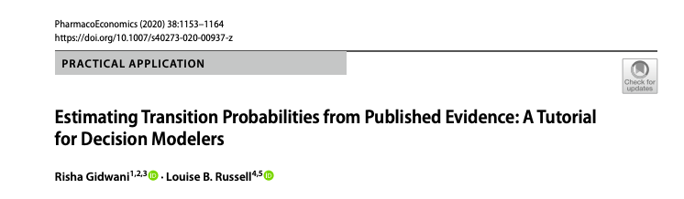
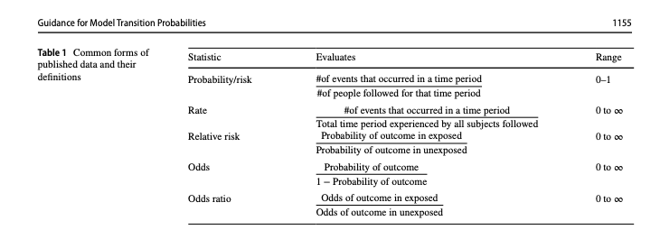
d. A different treatment effectiveness measure (RR, OR, etc.)

Slide 9
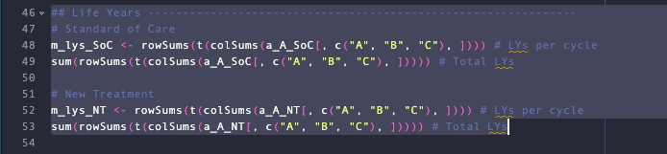
e. Incorporating utilities into your model (to obtain incremental costs per QALY gained)

Slide 10
Final exercise
To express the ICER as incremental costs per QALY gained
Annual utility value of state “A” = 0.8
Annual utility value of state “B” = 0.65
Annual utility value of state “C” = 0.6
Annual utility value of “Death” = 0

Slide 11
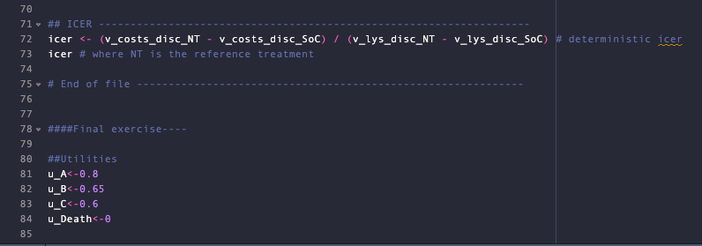
Final exercise

Slide 12
Thanks!

